Slide 1





Towards a Sustainable Energy Grid
Aziz Dhouib, Sebastien Behaghel, Damien Spay, Alex Riou

Slide 2

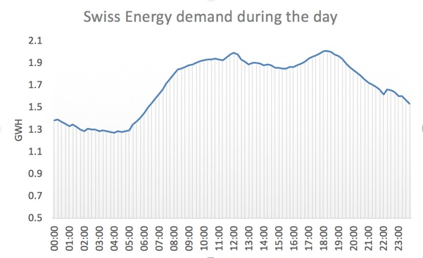
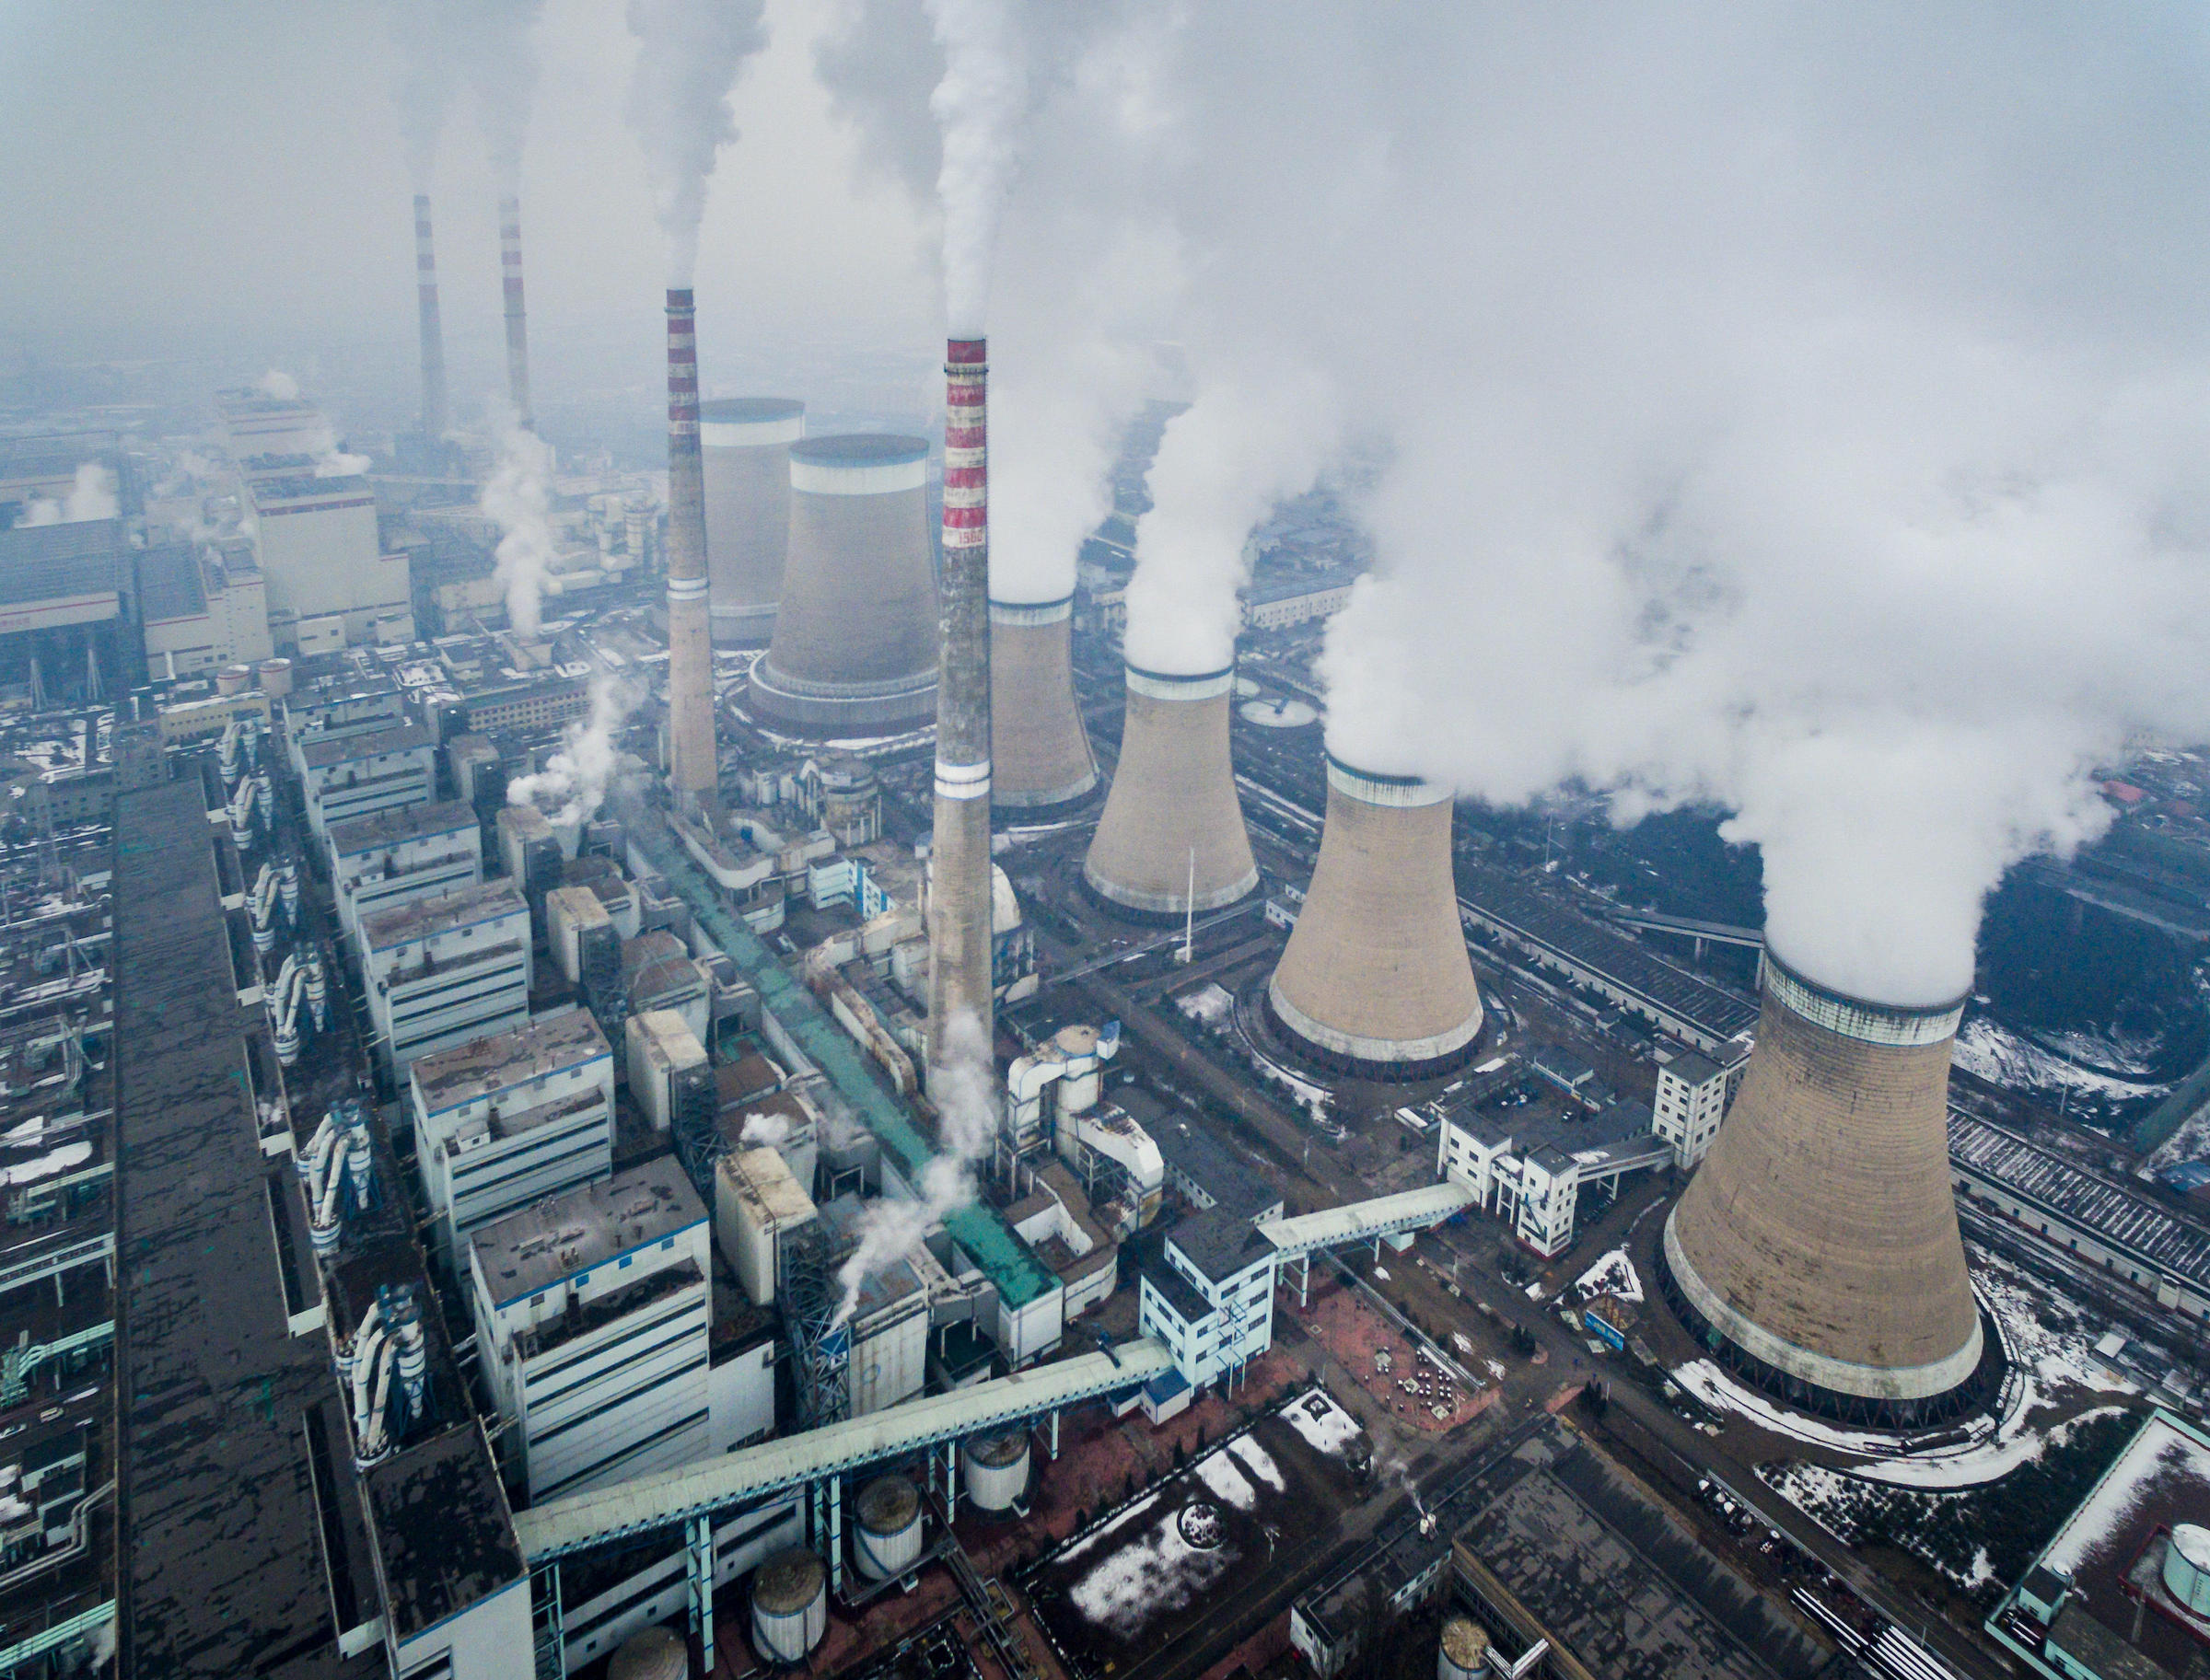

Grids were not designed for
Electric vehicules
Datacenters
Renewables
Screens abundance
Highly occurring natural disasters
Microgrids and locally produced energy
…

Slide 3
What do we need?

Slide 4
Storage

Slide 5
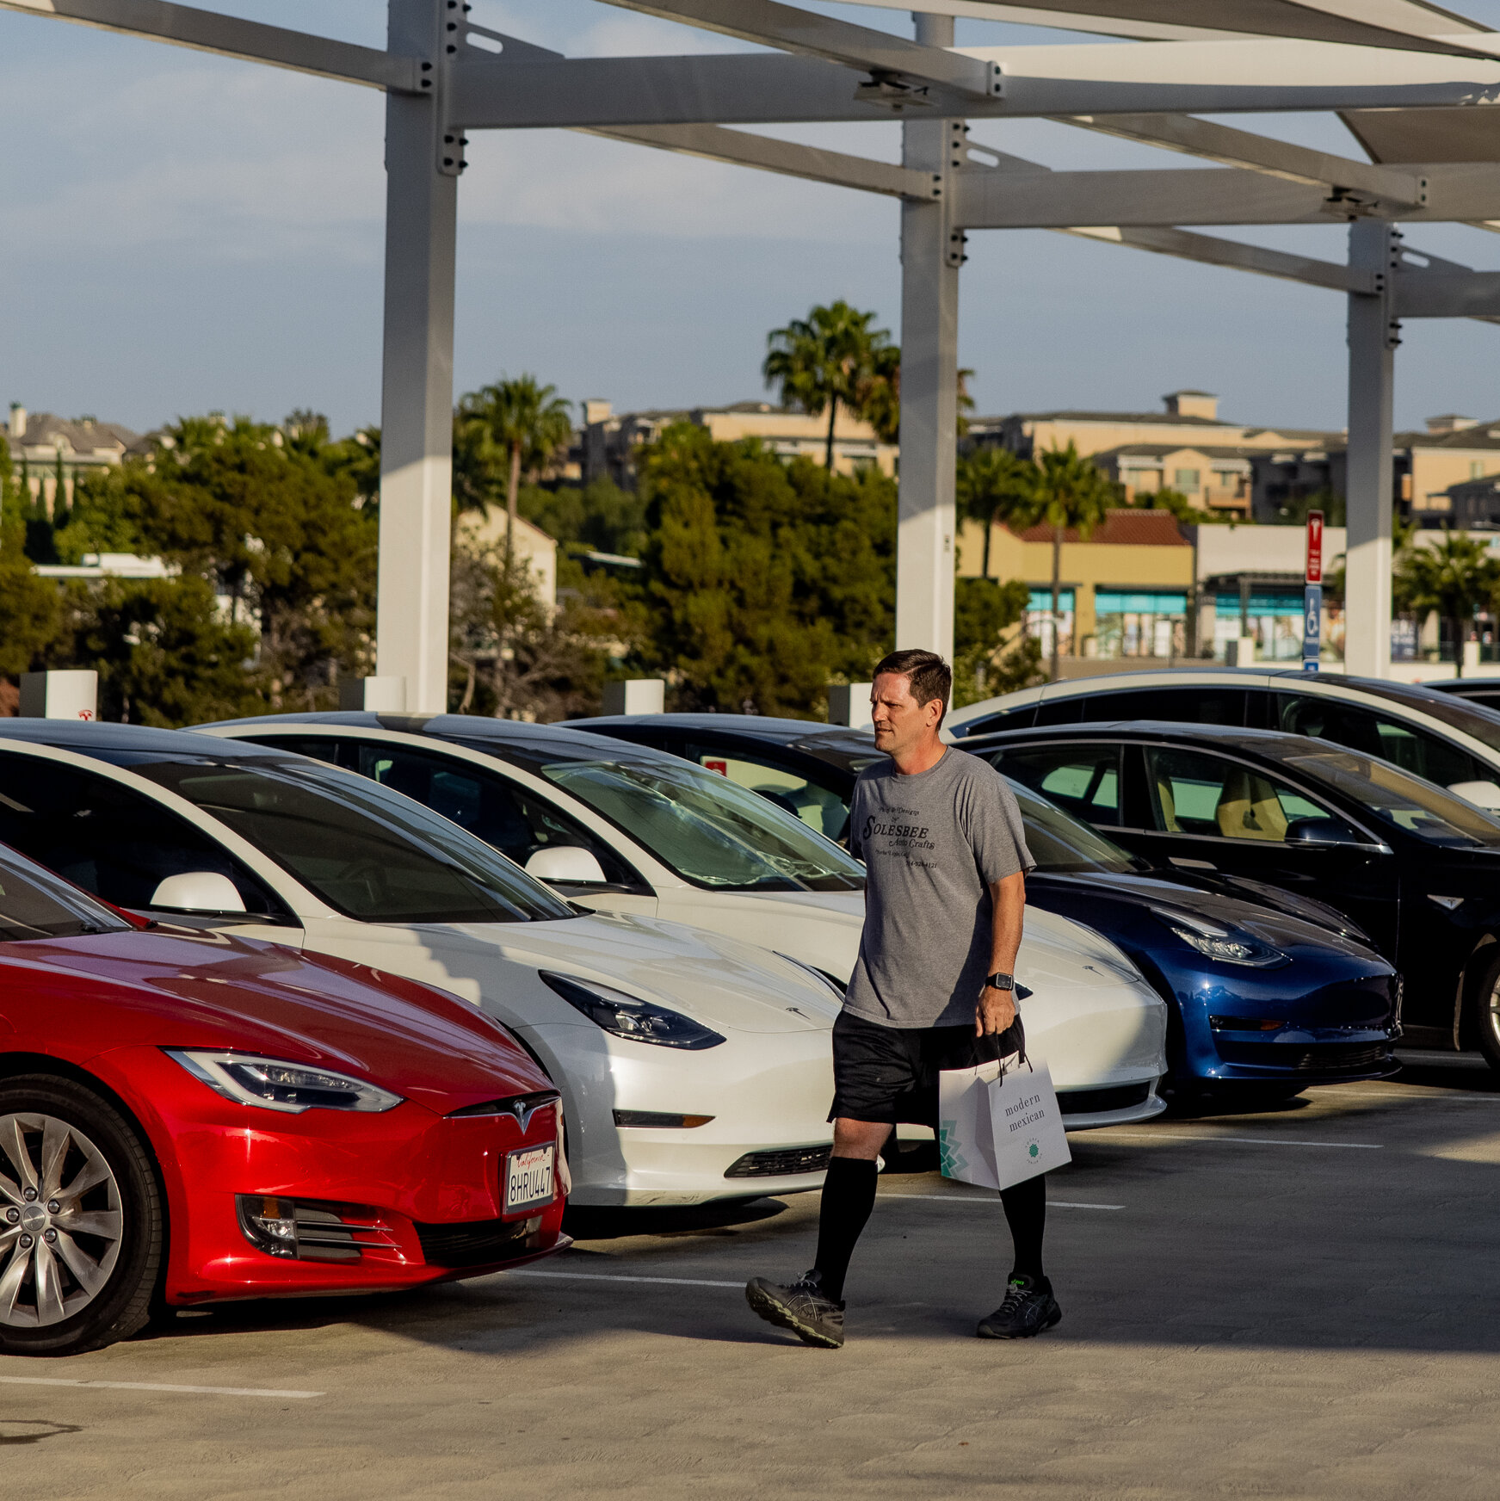

Slide 6

Fact -
Sales of electric vehicles in Switzerland are at 21% in 2021 – predicted 100% in 2035

Slide 7

07
NDG as pioneer of renting grid scale electrical storage
According to our predictions, today , EVs could replace entirely Swiss electricity production at peak times for a whole hour!

Slide 8
Strategy
Partnership with major utility companies
Collaborating with car owners
Making useful data available
using their batteries everyday in exchange of compensations
to certain business who needs it to develop further
offering storage capabilities to optimize their energy supply

Slide 9
They have constantly evolving and changing energy demand and have to maintain and operate many power plants, some of them not profitable.
Benefiting from our batteries, they can output steady amount of energy even when demand is low, using it later when demand is high, permitting them to reduce power production capabilities by a theoretical 1 GWh ~$2 Billion/year
Utilities

Slide 10
10
How will it work?
How will it work?
The AI will, thanks to data and training will be able to optimise the continuous charging and discharging of all betteries on the grid

Slide 11
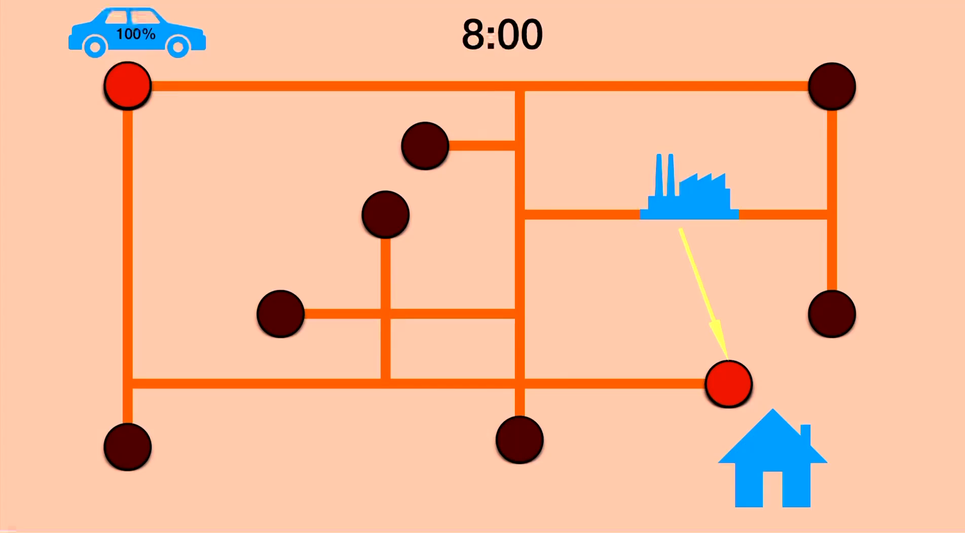

Slide 12

Data gathered and purchased
Artificial Intelligence
RNN
MLP
Notes:
MLP to RNN

Slide 13



Car owners
Sustainable incentive
Financial incentive
Longer lasting battery
Lowering carbon emissions by up to 4%
With up to 5 000 chf per year of compensations, buying electric cars can be a great investment as well
Trained AI will keep the bettery most of the time in the sweet spot, between 20 and 80 % charge, avoiding full charges and discharged that reduce battery life
https://www.figma.com/proto/b9eYr5TCkUgyCBEBWIZM5K/Untitled?node-id=2%3A2&starting-point-node-id=2%3A2

Slide 14

Extensive data
Free or occupied charging stations
Electric vehicle locations
Population movements

Slide 15


Timeline
AI Development
Initial growth
Mass growth
Implementation in Lausanne
Hardware
Exporting model in other cantons
April-Sept 2022
Sept- Dec 2022
Jan-Dec 2024
Jan- Dec 2025
2026
Cash Flow($)
-1,700,000
-3,000,0000
-500,000
0
Positive cash flow
Location
Vaud
Switzerland
Worldwide
Market($)
100,000,000
2,000,000,000
120,000,000,000

Slide 16


NDG
Help us bring down global emissions by 0,7%

Slide 17
https://www.bfe.admin.ch/bfe/en/home/supply/statistics-and-geodata/energy-statistics/overall-energy-statistics.html
https://www.swissgrid.ch/fr/home/newsroom/blog/2022/un-modele-d-affaires-pas-comme-les-autres.html
https://www.axpo.com/ch/en/about-us/media-and-politics/power-market-switzerland.html#:~:text=Electricity%20prices%3A%20There%20are%20major,to%20a%20difference%20of%2047%25.
https://www.energy.gov/eere/solar/solar-integration-inverters-and-grid-services-basics
https://www.iea.org/countries/switzerland
https://opendata.swiss/en/dataset/?q=consumption_2015_Stand_20160316.csv&groups=energy&sort=score+desc%2C+metadata_modified+desc
https://www.energyweb.org/industries/grid-operators/
https://www.accenture.com/us-en/services/sustainability-index
https://data.world/databeats/household-power-consumption

